Slide 1
DBMS- Session2

Slide 2
Course Objective
To understand and familiarize with Entity Relationship(ER) Model.

Slide 3
Session Objective
Entity Relationship Model
Types of Entities
Types of Attributes
Relationships
Degree of Relationships
Cardinality of Relationships

Slide 4
Entity-Relationship (ER) Model
ER model helps to capture conceptual database design
Adopts top-down approach
Describes the functional data requirements of a real-world problem in the form of ER diagrams
Consists of Attributes, Entities, Relationships, Identifiers
UML class diagrams is representative of another way of displaying ER concepts

Slide 5
Entity and Attribute
Entities
Entities are specific objects or things that are represented in the database.
Example:
The Student , the Book
Attributes
Attributes are properties used to describe an entity.
Example:
STUDENT entity may have the attributes Name, Reg. no, Address, Degree, BirthDate
Each attribute has a value set associated with it.
Example:
Attribute Age associated with value ranges from 18 to 52, attribute Department should have values ‘CS’, ‘EE’,’ME’,’CV’
Notes:
Data: symbols Information: data that are processed to be useful; provides answers to "who", "what", "where", and "when" questions Data... data is raw. It simply exists and has no significance beyond its existence (in and of itself). It can exist in any form, usable or not. It does not have meaning of itself. In computer parlance, a spreadsheet generally starts out by holding data.
Information... information is data that has been given meaning by way of relational connection. This "meaning" can be useful, but does not have to be. In computer parlance, a relational database makes information from the data stored within it.

Slide 6
Types of Entities
Strong/Regular Entity
It can exist independently of other types of entities
It has its own unique identifier
Example:
The Student Entity can exist independent of any other entitles
Weak Entity
It is dependent on a strong entity (identifying owner)…cannot exist on its own
It does not have a unique identifier (only a partial identifier)
Example:
Nominee Entity cannot exist independent of Policy-Holder Entity
Notes:
Data: symbols Information: data that are processed to be useful; provides answers to "who", "what", "where", and "when" questions Data... data is raw. It simply exists and has no significance beyond its existence (in and of itself). It can exist in any form, usable or not. It does not have meaning of itself. In computer parlance, a spreadsheet generally starts out by holding data.
Information... information is data that has been given meaning by way of relational connection. This "meaning" can be useful, but does not have to be. In computer parlance, a relational database makes information from the data stored within it.

Slide 7
Types of attributes
Simple Vs Composite
Single valued Vs Multi-valued
Simple attribute
An attribute, which cannot be sub-divided further components
Example: Age, Sex. These attributes cannot be divided into subcomponents
Composite attribute
Attribute may be composed of several components
Example: Address, Name. Address attributes can be composted of door no., street, city, state, whereas Name can compose of First Name, Last Name
Address
Door No.
Street
State
City
7

Slide 8
Types of attributes contd…
Single valued attribute
An attribute, which has only single atomic values
Example:
Age, DOB, Sex. These attribute values are single and atomic
Multi-valued attribute
An Attribute may have multiple values
Example:
Attribute Degree can have values ‘B.Tech’ and ‘M.Tech’, attribute hobby can have values ‘playing cricket’ and ‘watching cricket’
Key Attribute/Identifier
An attribute of an entity type (Collection of similar entities) for which each entity must have a unique value is called a key attribute of the entity type.
Example:
EmployeeNo. of EMPLOYEE is key attribute
8

Slide 9
Relationships
A relationship relates two or more distinct entities with a specific meaning
Shyam manages the Finance Department
Relationships of the same type are grouped or typed into a relationship type
Example:
the MANAGES relationship type in which EMPLOYEEs and DEPARTMENTs participate
the WORKSON relationship type in which EMPLOYEEs and PROJECTs participate
Relationships can have attributes, which describe features pertaining to the association between the entities in the relationship
Identifying relationship
links strong entities to weak entities
9

Slide 10
Degree of Relationships
Degree of a relationship is the number of entity types that participate in it.
Unary relationship
Binary relationship
Ternary relationship
Unary relationship (degree 1)
One entity related to another of the same entity type
Example: Employee Manages other Employee
Binary relationship (degree 2)
Entities of two different types related to each other
Example: Supplier supplies Quotations
Ternary relationship (degree 3)
Entities of three different types related to each other
Example: Parental relationship between mother, father and child
10

Slide 11
Cardinality of Relationships
The number of entity instances that may participate in a relationship instance
One-to-one (1:1)
Each entity in the relationship will have exactly one related entity
One-to-many (1:N) or Many-to-one (N:1)
An entity on one side of the relationship can have many related entities, but an entity on the other side will have a maximum of one related entity
Many-to-many (M:N)
Entities on both sides of the relationship can have many related entities on the other side
11

Slide 12
One to One
HOD
1
1
DEPARTMENT
Manage
A HOD manages one Department.
Each Department is managed by one HOD
12

Slide 13
One to Many
It reflects business rule that one entity is associated with many number of same entity.
A Subject can be offered many times
Each Offering belongs to one Subject
Subject
1
N
Offerings
Has
13

Slide 14
Many to Many
A Teacher can teach many different Subjects
Each Subject can be taught by many Teacher
Teacher
M
N
Subjects
Teaches
14

Slide 15
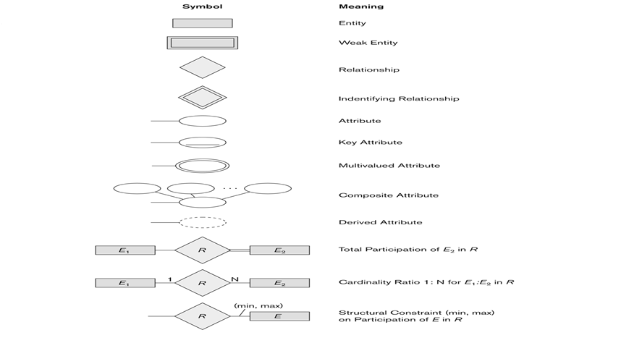
ER Notations
15

Slide 16
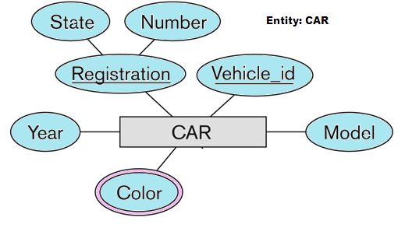
Entity and Attributes representation using ER notation
Entity is represented using Rectangle, attributes are represented with ellipse and key attributes/identifiers are underlined

Slide 17
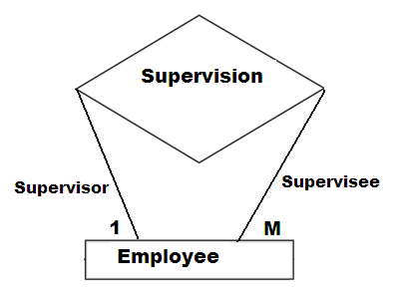
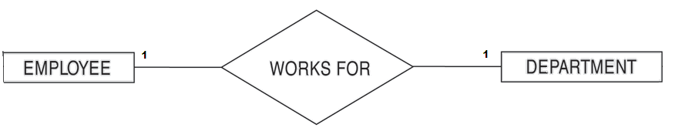
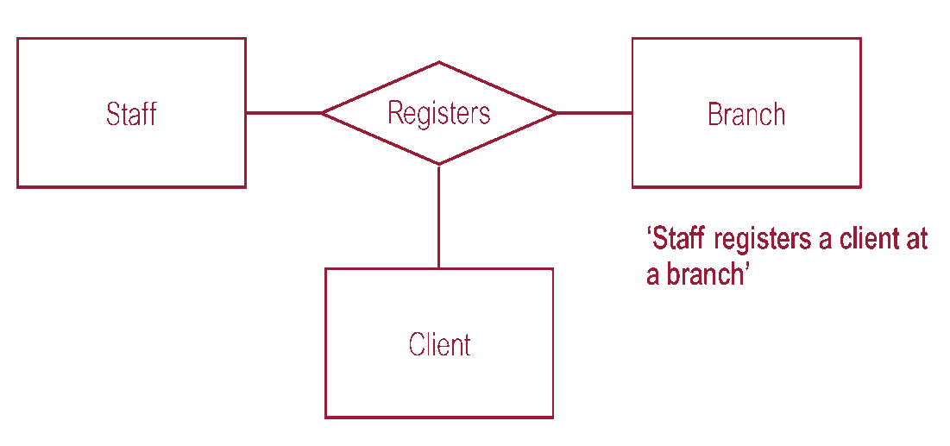
Relationships representation using ER notation

Slide 18
Case study
Objective:
To make the participants familiarize with ER-Diagrams.

